Slide 1
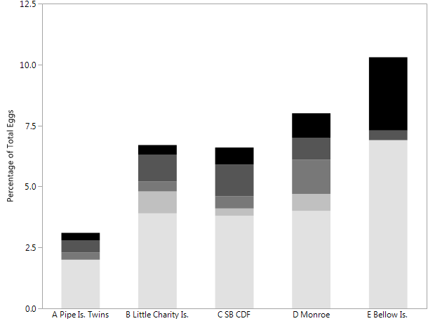
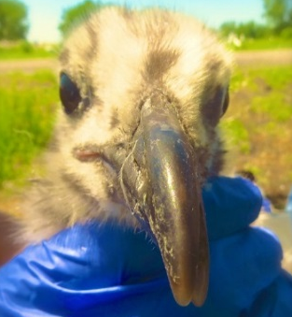
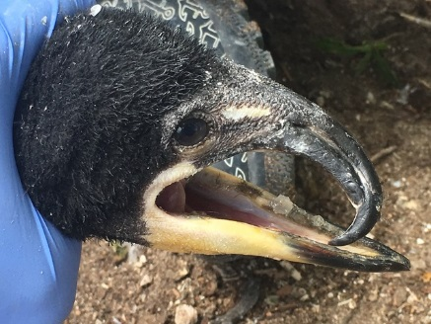
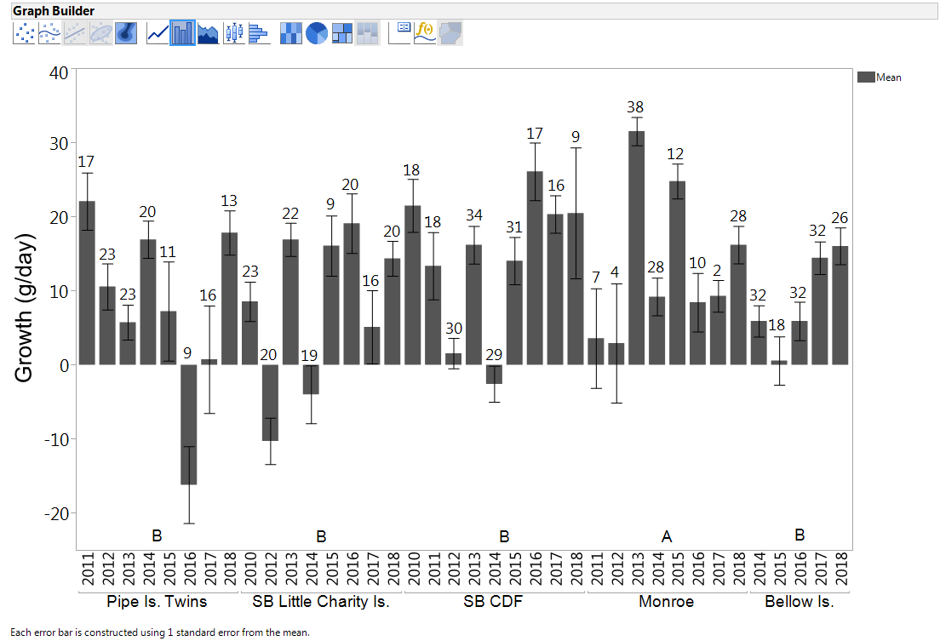
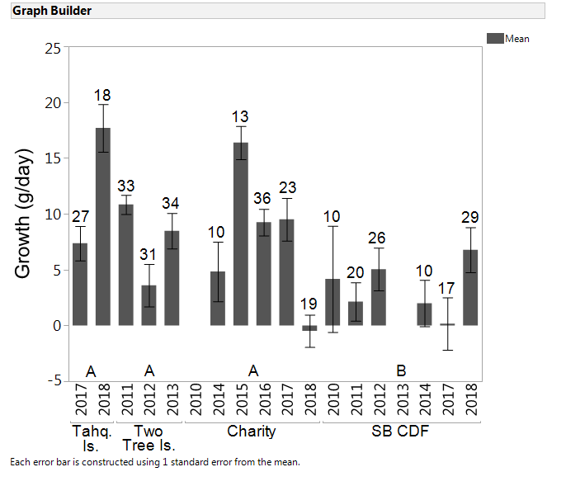
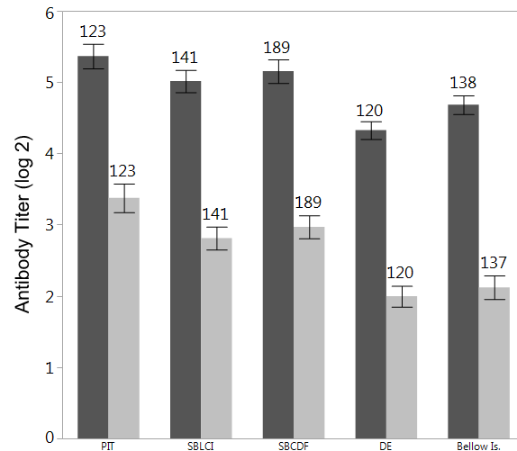
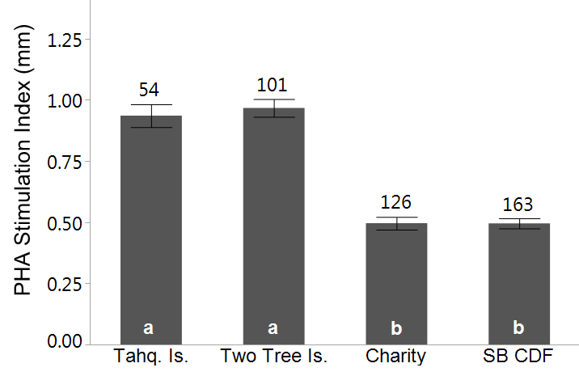
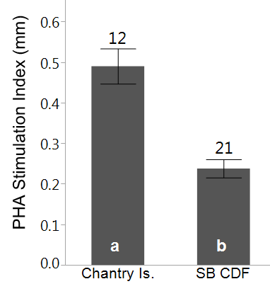
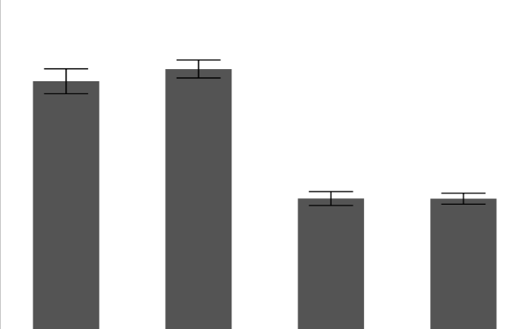
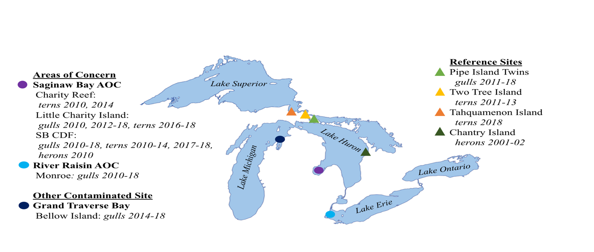
Great Lakes Colonial Waterbirds as Sentinels for Continuing Reproductive and Health Impairments at Contaminated Sites in Michigan during 2010-18
K. A. Grasman, M. Bleitz, L. Dykstra, G. Gardner, Department of Biology, Calvin College, Grand Rapids, MI
M. Annis, J. Moore, L. Williams, U.S. Fish and Wildlife Service, Region 3, East Lansing, MI
Introduction
Table 1. Relative risk ratios for incidence rates of embryonic nonviability, fertility, and failed development in herring gulls in the Saginaw Bay and River Raisin AOCs and Grand Traverse Bay compared to the reference site (Pipe Island Twins) during 2010-18.
A.
B.
C.
A) Herring Gull
B) Caspian Tern
231
ANOVA
Site: p<0.0001
ANOVA
Site: p < 0.05
Significant concentrations of persistent organic pollutants including polychlorinated biphenyls (PCBs), chlorinated dioxins and furans, and organochlorine pesticides have contaminated the Great Lakes since their introduction during the 1940s-60s. Studies from the late 1960s onward have shown that fish-eating birds of the Great Lakes are excellent sentinel species for assessing and monitoring effects of contaminants including reproductive problems, deformities, and immune suppression (Grasman et al. 1996, 1998). PCBs and dioxins have been associated with Great Lakes Embryo Mortality, Edema, and Deformities Syndrome (GLEMEDS; Grasman et al. 1998). GLEMEDS in wild birds parallels chick edema disease in chickens, which is caused by the same contaminants (Gilbertson et al. 1991) and produces similar symptoms such as crossed bills, edema, gastroschisis, and embryonic mortality. Suppression of T cell-mediated immunity has been associated previously with organochlorines in young herring gulls and Caspian terns at contaminated Great Lakes sites (Grasman et al. 1996).
The Great Lakes Water Quality Agreement recognizes 14 Beneficial Use Impairments (BUIs) caused by contaminants at specially designated Areas of Concern (AOCs) and in lake-wide regions. Two wildlife-related BUIs are directly relevant to the background discussed above and to the present study: 1) bird or animal deformities or reproductive problems and 2) degraded fish and wildlife populations. The present study is a reassessment of these BUIs in the Saginaw Bay and River Raisin AOCs as part of the US Fish and Wildlife Service’s broader efforts under the Great Lakes Restoration Initiative (GLRI) Funding for AOCs and remediation and restoration of contaminated sediments. In 2014, Grand Traverse Bay was added as a new site. Herring gull eggs from Bellow Island in Grand Traverse Bay have elevated dioxin toxic equivalents (TEQs) despite medium PCB concentrations, and also elevated DDE concentrations (Bowerman et al. 2011). This unique mixture of contaminants may be a result of the herbicides and insecticides used on orchards surrounding the Grand Traverse Bay.
The specific purpose of this study was to reassess the reproduction, growth, and immunological health of colonial waterbirds in the Saginaw Bay and River Raisin AOCs and Grand Traverse Bay. Endpoints used in this assessment included embryonic mortality, deformities, overall reproductive success, chick growth, and T cell and antibody-mediated immune responses in chicks. Low immune responses, including the phytohemagglutanin (PHA) skin response (a measure of T cell function), are associated with reduced survival and dispersal in wild song birds (Moeller and Saino 2004, Moeller and Cassey 2004). Herring gulls from the reference colonies chosen for this study (Fig. 1) have low concentrations of organochlorines compared to those collected from the Saginaw Bay and River Raisin AOCs and Grand Traverse Bay (Bowerman et al. 2011).
Percentage of Total Eggs
462
741
693
393
D.
E.
F.
G.
b
Pipe Is. SB Little SB CDF Monroe Bellow Is.
a
a
b
a
a
a
a
a
a
Twins Charity Is.
Pipe Is. Twins SB Little Charity Is. SB CDF Monroe Bellow Is.
Tahq. Two Charity SB CDF
Figure 2. Embryonic nonviability in herring gulls at the Reference site, Saginaw Bay and River Raisin AOCs and Grand Traverse Bay during 2010, 2012-18. Numbers on bars are egg totals. “Undetermined” describes infertile or failed eggs that could not be distinguished due to addling.
Figure 3. Cross-billed colonial waterbird chicks and embryos observed at AOCs during this study: herring gulls at Monroe in 2012 (A), 2013 (B), and 2016 (C); a Caspian tern on L. Charity Is. in 2016 (D); herring gull embryos on the SB CDF in 2016 (D) and L. Charity Is. in 2017 (E); and a cormorant on L. Charity Is. in 2017 (G).
Is. Tree Is.
Figure 4. Reproductive productivity (number of 3 week old chicks surviving per nest in an enclosure) at AOCs, Grand Traverse Bay, and reference sites in 2010-18. For herring gulls, productivity of 0.8 chicks/nest or greater is necessary to maintain a stable population (Kadlec and Drury 1968). Dotted lines indicate site means. Sites with the same letter(s) were not statistically different by Tukey’s test (p < 0.05).
A) Herring Gull
ANOVA
Site: p< 0.0001
B) Caspian Tern
ANOVA
Site: p< 0.0001
A) Herring Gull
B) Caspian Tern
C) Black-Crowned Night Heron
A) Herring Gull
B) Caspian Tern
ANOVA
Site: p< 0.0001
ANOVA
Site: p< 0.0001
T-test
Site: p<0.05
Total ANOVA Site: p<0.0001
IgG ANOVA Site: p<0.0001
Total ANOVA Site: p<0.0009
IgG ANOVA Site: p<0.009
54
101
126
163
138
A
C
BC
AB
B
B
AB
A
A
B
AB
A
AB
AB
B
B
a
a
b
b
A
A
Tahq. Is. Two Charity SB CDF
Pipe Is. SB Little SB CDF Monroe Bellow Is.
Tree Is.
Twins Charity Is.
Figure 5. Mean change in body mass between 3 and 4 weeks of age in pre-fledgling fish-eating birds at Great Lakes AOCs, Grand Traverse Bay, and reference sites in 2010-18. Numbers on bars indicate sample sizes, and error bars indicate standard errors. Dotted lines indicate site means. Sites with the same letter(s) were not statistically different by Tukey’s test (p < 0.05).
Figure 6. Mean phytohemagglutinin (PHA) stimulation index, a measure of T cell-mediated immunity, in pre-fledging fish-eating birds at AOCs, Grand Traverse Bay, and reference sites in 2010-18. Numbers on bars indicate sample sizes, and error bars indicate standard errors. Dotted lines indicate site means. Sites with the same letter(s) were not statistically different by Tukey’s test (p < 0.05).
Figure 7. Mean total and IgG antibody titers in pre-fledging herring gulls at AOCs, Grand Traverse Bay, and reference sites in 2010-18. Sites sharing letter(s) were not significantly different by Tukey’s test (p < 0.05). Numbers indicate sample sizes. Error bars indicate the standard error.
Materials and Methods
Results and Discussion
Conclusions
Embryonic Nonviability
Herring gull nests containing one to two eggs were marked during laying. Embryonic viability was assessed during mid incubation (19-21 days) using an Avitronics Digital Egg Monitor (Cornwall England), which measures the embryo's heart rate and movement. Nonviable eggs were opened to identity infertility, stage of development, and deformities.
Growth and Reproductive Success
Body mass was measured at 3 and 4 weeks to evaluate the growth rate of chicks.
Productivity was calculated as the number of 3 week chicks per nest.
Immune Function
T cell-mediated immune response: The initial wing web thickness of 3 week gulls and terns and 2 week herons was measured with pressure sensitive calipers. The chicks were then injected with an irritant, phytohemagglutinin (PHA), in one wing and a placebo of phosphate buffered saline (PBS) in the other. The wing web thickness was re-measured 24 hours post-injection to quantify the T cell-mediated response. The PHA stimulation index was calculated as the difference between the inflammatory responses at the PHA and PBS injection sites (Grasman et al. 1996).
Antibody response: Sheep red blood cells (SRBCs) were injected into 3 week chicks to stimulate antibody production. Antibody titers were measured in plasma of 4 week old chicks by serial dilution of plasma and incubation with SRBCs. IgG antibody response was assessed by adding 2-mercaptoethanol to denature IgM antibodies prior to addition of SRBCs. The titer representing total and IgG antibody response was the highest dilution in which agglutination formed between the antigen and antibody. (Grasman et al. 1996).
Embryonic Nonviability and Deformities
Embryonic nonviability rates in late incubation herring gull eggs were elevated on both islands in the Saginaw Bay AOC (6.6-6.7%), in the River Raisin AOC (8.1%), and in Grand Traverse Bay (10.4%) compared to the Pipe Is. Twins reference site (3.1%; Fig. 2). Infertility was the primary cause of nonviability at the reference sites; elevated rates of infertility and embryonic death (failed development) contributed to higher rates of total nonviability at both AOCs and Grand Traverse Bay.
Nonviability data were analyzed by calculating relative risk (RR) ratios based on the incidence rates of infertility and embryonic death at contaminated sites relative to the reference site. RR ratios of 1 indicate no difference in incidence rates between groups. There was strong statistical evidence that the RR ratios for infertility (p values from <0.037 to <0.0019) and failed development (p values from <0.022 to <0.0017) were elevated 2-3.4 and 2.75-4 fold, respectively, at the AOCs and Grand Traverse Bay compared to the reference sites. The RR ratios for overall nonviability (p values from <0.0084 to <0.0002) were also elevated 2-3.5 fold at the AOCs and Grand Traverse Bay (Table 1). These conclusions held for individual islands, grouping islands within the Saginaw Bay AOC, and grouping both AOCs and Grand Traverse Bay together.
During the course of this study a number of embryos and chicks have been observed with deformities such as crossed bills (Fig. 3) and gastroschisis, but only at AOC colonies. Embryonic nonviability and deformities such as crossed bills and gastroschisis are characteristic of GLEMEDS and are associated with exposure to PCBs and dioxins (Gilbertson et al. 1991, Grasman et al., 1998).
Reproductive Success
While productivity was consistently stable at reference colonies, herring gulls in the River Raisin AOC and Caspian terns in the Saginaw Bay AOC had the lowest mean productivity and experienced complete (or nearly complete) colony-level reproductive failure in several years (Fig. 4). Mean productivity of 3 week herring gulls differed significantly among sites (ANOVA p<0.0001; Fig. 4A), with the highest mean productivity at the Saginaw Bay CDF and the lowest mean productivity (1.1 chicks/nest) at the River Raisin AOC. All overall site means were above the level necessary to maintain a stable population (0.8 chicks/nest, Kadlec and Drury 1968). However, productivity at Monroe was below 0.8 chicks/nest in four of nine years, including complete reproductive failure in one year. Mean productivity of 3 week Caspian tern chicks was 37% lower in Saginaw Bay compared to reference sites (ANOVA p<0.0075; Fig. 4B). When the four contaminated sites were ordered by PCB concentrations, there was strong statistical evidence for decreasing productivity with increasing PCBs (Jonckheere P<0.040). Overall these data indicate a continuing and consistent reproductive impairment in Caspian terns, a state-threatened species, in the Saginaw Bay AOC.
Growth
Growth (weight gain) in pre-fledgling gulls differed significantly among sites (ANOVA p<0.0001), with Monroe in the Raisin River AOC significantly higher than all other colonies (Fig. 5A). Only Monroe had a mean multiyear growth rate in the expected range for herring gull chicks of 14-20 g/day established by a previous study (Grasman et al., 1996). Although Monroe had the highest mean growth rate overall, it was below the expected range in five out of nine years of the study. Gull chicks at both AOCs and Bellow Island had poor growth rates in almost half of the years studied. Mean weight loss or wasting in Caspian tern and herring gull chicks was observed in the Saginaw Bay AOC (three years on Little Charity Island and one year on the SB CDF) and one year on the Pipe Is. Twins reference site. Mean growth in tern chicks was significantly lower on the SB CDF compared to all other colonies (ANOVA p<0.0001; Fig. 5B) and was below the expected range of 4.0-18.0 g/day for Caspian terns (Grasman et al., 1996). The low growth rates at the herring gull reference colony are most likely due to low food supplies. However, food is abundant in the highly productive Saginaw Bay and River Raisin AOCs, so food shortages are not likely to be responsible for poor growth in gulls and terns in these areas.
T Cell-Mediated Immunity
Herring gulls and Caspian tern chicks had lower T cell-mediated immune responses at all AOC sites as well as at Grand Traverse Bay compared to the reference sites (ANOVA p<0.0001; Fig. 6). The mean PHA skin response of gulls was 54-56% lower at the AOCs, and 50% lower in Grand Traverse Bay than at the Pipe Island Twins site. Caspian terns at AOCs had a 48% lower mean response as compared to the reference sites. Black-crowned night herons on the SB CDF showed a 39% lower T cell response compared to herons at the Chantry Island reference site (T-test p<0.05) (Fig. 6C). The magnitude of the suppression in the PHA response at the AOCs and Grand Traverse Bay was biologically significant and comparable to the complete removal of the thymus gland in chickens, which causes a reduction in the stimulation index by approximately 50-60% (Grasman et al. 1996). Furthermore, lower PHA responses have been associated with reduced survival and dispersal in wild birds (Moeller and Saino 2004, Moeller and Cassey 2004).
Antibody Response
Pre-fledgling herring gulls at the River Raisin AOC and in Grand Traverse Bay had a 2-3 fold lower total antibody and IgG responses than herring gulls at the Pipe Island Twins reference site (ANOVA p<0.0001 for total, p<0.0001 for IgG; Fig. 7A). Total and IgG responses in gulls in the Saginaw Bay AOC were similar to those at the reference site. Total antibody responses in Caspian terns were significantly higher at Charity than Two Tree Is. and the SB CDF (ANOVA p<0.0009; Fig. 7B). IgG responses were significantly lower at Tahquamenon Is. than at Charity (ANOVA p<0.0087).
Herring gulls, Caspian terns, and black-crowned night herons in the Saginaw Bay AOC showed impairments in immune responses and (or) reproduction consistent with past studies
Embryonic infertility and failed development were elevated in gulls
Terns had lower overall productivity in the AOC when compared to reference sites
Growth of tern chicks was significantly lower on the SB CDF than the reference site
Suppressed T cell-mediated immunity was demonstrated in herring gulls, Caspian terns, and black-crowned night herons
Herring gulls at the River Raisin AOC showed impairments in immune responses and reproduction, consistent with past studies
Embryonic nonviability, including both infertility and failed development, was elevated in gulls in the River Raisin AOC
Complete reproductive failure in one year, and low chick productivity in three other years
Low growth rates in gull chicks in five out of nine years
Suppressed T cell-mediated immune response
Suppressed total antibody and IgG responses
Herring gulls at the Grand Traverse Bay colony, a site with high TEQs and DDEs, showed impairments in immune responses and reproduction
Elevated embryonic nonviability, including both infertility and failed development
Low growth rates three out of five years
Suppressed T cell-mediated immune response
Suppressed total antibody and IgG responses
Acknowledgements
This project was supported by the Great Lakes Restoration Initiative Funding for Area of Concern and Remediation and Restoration of Contaminated Sediments through the U. S. Fish and Wildlife Service, Region 3. Ted Ludwig, Jim Ludwig, Dave Best, Therese Best, Lisa Fischer, and Rachael Pierce provided logistical support in the field.
References
Bowerman, W., L. Moore, K. Leith, K. Drouillard, J. Sikarskie, D. Best, T. Allan, J. Garvon, W. Scharf, J. Perlinger, M. Romanski. 2011. Report to Michigan Department of Environmental Quality, Water Resources Division, Lansing, MI.
Gilbertson, M., T. Kubiak, J. Ludwig, and G. Fox. 1991. Journal of Toxicology and Environmental Health 33:455-520.
Grasman, K.A., G. Fox, P. Scanlon, and J. Ludwig. 1996. Journal of Toxicology and Environmental Health 104:29-842.
Grasman, K.A., P. Scanlon, and G. Fox. 1998. Environmental Monitoring and Assessment 53:117-145.
Kadlec, J.A., and W.H. Drury. 1968. Ecology 49:644-676.
Moller, A. and P. Cassey. 2004. Journal of Animal Ecology 73:1035-1042.
Moller, A. and N. Saino. 2004. Oikos 104:299-304.
Figure 1. Colonial waterbird colonies studied in Great Lakes AOCs, Grand Traverse Bay, and reference sites for this assessment of health and reproduction in fish-eating birds during 2010-18.
Notes:
Figure 1. Colonial water-bird colony locations studied in Great Lakes AOCs, other polluted sites, and reference sites for this assessment of health and reproduction in fish-eating birds during 2010-18.

